Slide 1

Movie Rental Analysis
Sakila DVD Rental Store Data set
B.Naveen Kumar

Slide 2
Agenda
Introduction
Exploratory Data Analysis(EDA)
Power BI (Q)
All Insights
Appendix
Presentation Title

Slide 3

Introduction
Optimizing Business Performance: Insights from Sakila DVD Rental Store Database Analysis
With that context in mind, let's begin our exploration of the insights and recommendations generated from our analysis of the Sakila DVD Rental Store Database.

Slide 4


Exploratory Data Analysis
Sql Queries

Slide 5
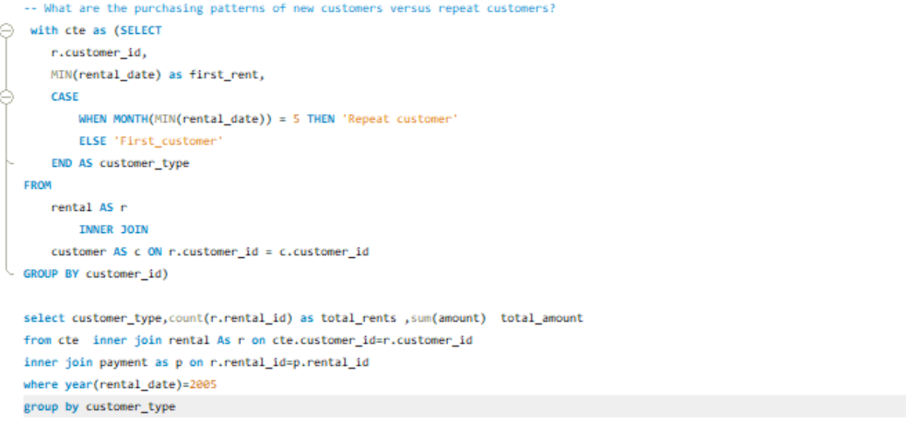
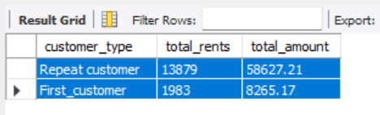
1.What are the purchasing patterns of new customers versus repeat customers?
Examine the Rents and Revenue (or basket size) for new customers versus repeat customers. Repeat customers may tend to Rent 87% Rents and revenue on total amount
New Customers have only 13 % rents and revenue

Slide 6
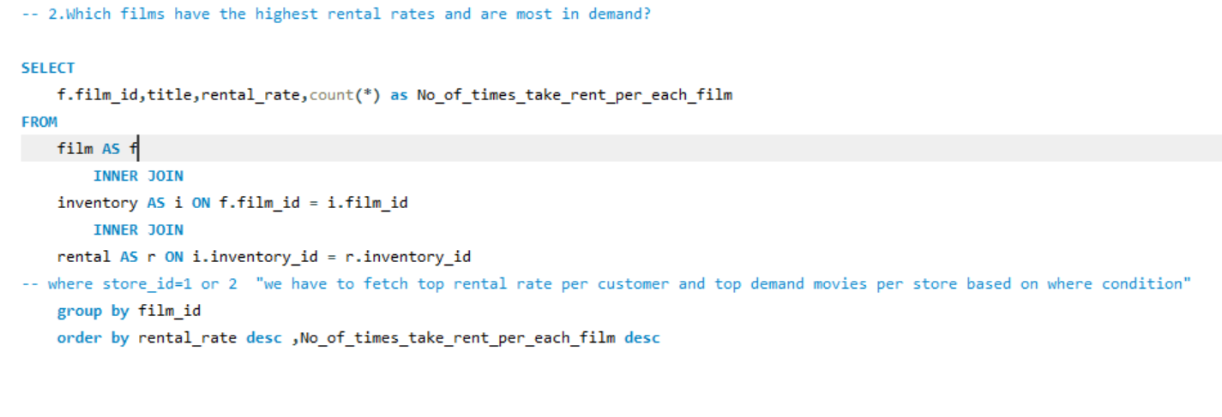
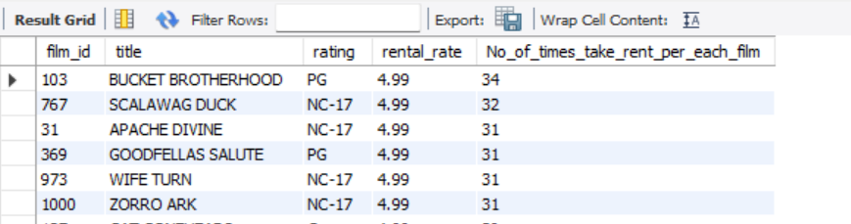
2.Which films have the highest rental rates and are most in demand?
(no of movies )
* as per the rentals rates 0.99 - 341
2.99 - 336
4.99 - 323 * BUCKET BROTHERHOOD , SCALAWAG DUCK ,APACHE DIVINE, GOODFELLAS SALUTE, WIFE TURN
These are leading films in DVD store

Slide 7

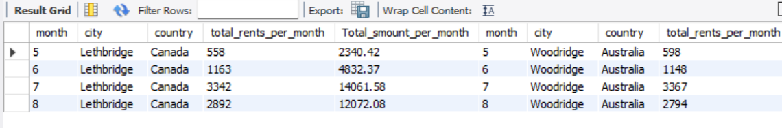
4. Are there seasonal trends in customer behavior across different locations?
* Summer break in Canada typically lasts from late June to early September, and is usually 8–10 weeks long.
* Holiday periods often see an increase in movie rentals as people have more leisure time and may gather with friends and family.
* Australia's seasons are at opposite to Canada means June to August is winter is Australia. during colder months, customers might prefer staying indoors and renting movies, leading to higher demand.
* Movie rental companies may offer promotions or discounts during the winter season to attract customers, particularly during school holidays or on weekends when people are more likely to stay indoors.

Slide 8
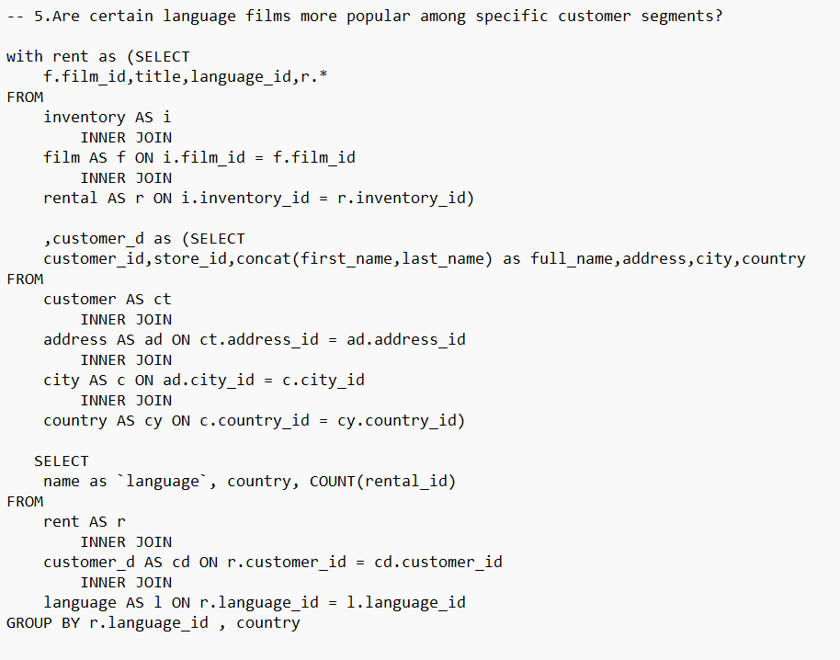
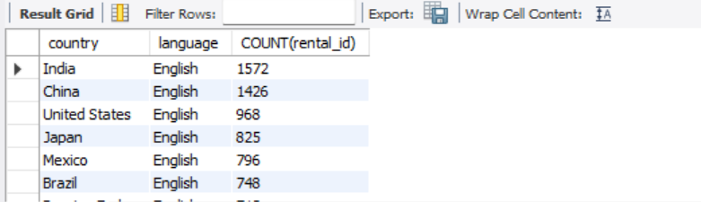
5. Are certain language films more popular among specific customer segments?
Customers who are fluent or proficient in a particular language may gravitate towards films in that language. Immigrants are living in Australia may prefer to watch films in their native language as a way to connect with their culture and language.
India and china have most popular customers in English language

Slide 9
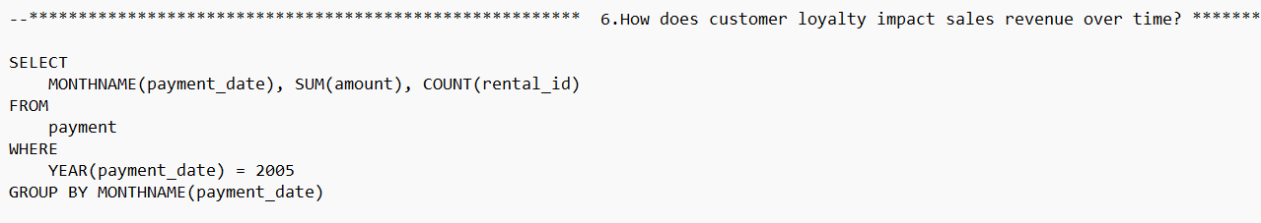
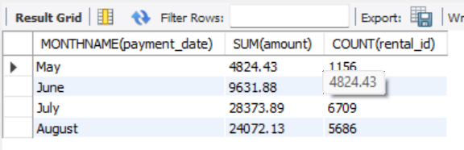
6. How does customer loyalty impact sales revenue over time?
*Definitely customer loyalty has impact on rent of movies .
*in the month of may we have only less number of rents and in the month of July and august have more revenue
*Loyal customers can lead to increased sales revenue over time because they are a stable source of income.
* Customer loyalty impact on Repeat Purchases and Reduce Marketing Cost and Mouth Refer
Movie Rental analysis

Slide 10
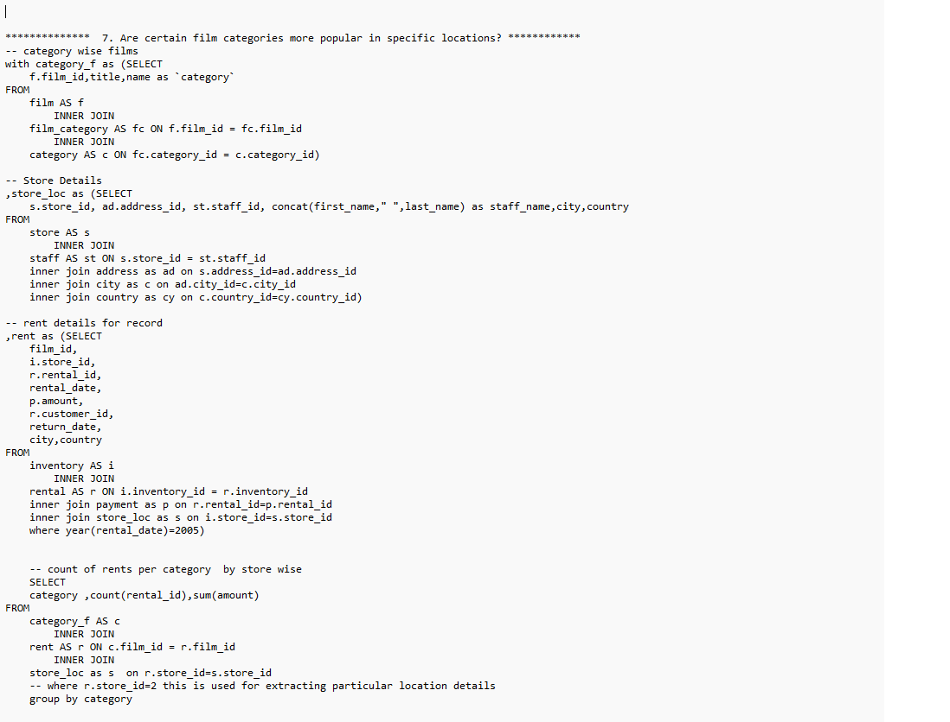
7. Are certain film categories more popular in specific locations?
* In Canada (Store 1), the Top 3 most popular categories are Action, Drama, Animation, each with over 500 rentals.
* In Australia (Store 2), the Top 3 most popular categories are Sports, Documentary, and Animation, with over 500 rentals each.
Movie Rental analysis

Slide 11
8. How does the availability and knowledge of staff affect customer ratings?
* The availability and knowledge of staff can have a significant impact on customer ratings in several ways:
1.Customer Service experience
2.Problem Resolution
3.Product Knowledge
4.Repeat Business and Loyalty of Customer:
Overall, the availability and knowledge of staff play a crucial role in shaping the customer experience and influencing ratings and reviews
Movie Rental analysis

Slide 12
9. How does the proximity of stores to customers impact rental frequency
* The proximity of stores to customers can have a significant impact on rental frequency in several ways:
1.Convenience:
Customers are more likely to rent from stores that are conveniently located near their homes or workplaces.
2.Frequency of Visits:
When stores are located nearby, customers may visit more frequently to browse new releases, return rentals, or explore different movie categories.
3.Customer Loyalty:
Stores located in close proximity to customers have the opportunity to build stronger relationships and loyalty. Regular interactions with staff and personalized service can enhance the customer experience and encourage repeat rentals.
4.Businesses that strategically position stores to be easily accessible and convenient for customers can maximize rental frequency and drive overall success.
Movie Rental analysis

Slide 13
10. Do specific film categories attract different age groups of customers?
Yes, specific film categories often attract different age groups of customers due to varying preferences, interests, and life stages.
Family Films: Family-friendly movies, including animated films and live-action adventures suitable for all ages, naturally attract children and their parents.
Action and Adventure: Action-packed films with intense sequences, thrilling stunts, and heroic characters tend to attract a broad audience, including teenagers and young adults.
Romantic Comedies and Dramas: Romance films, including romantic comedies and dramas, tend to appeal more to teenagers and adults.
Horror and Thrillers: Horror and thriller films, known for their suspenseful plots, supernatural elements, and intense scenes, typically attract teenagers and adults seeking excitement and adrenaline rushes.
Comedies: Comedy films, ranging from slapstick humor to witty satire, have broad appeal across different age groups. While teenagers and young adults might enjoy irreverent comedies with edgy humor
Movie Rental analysis

Slide 14
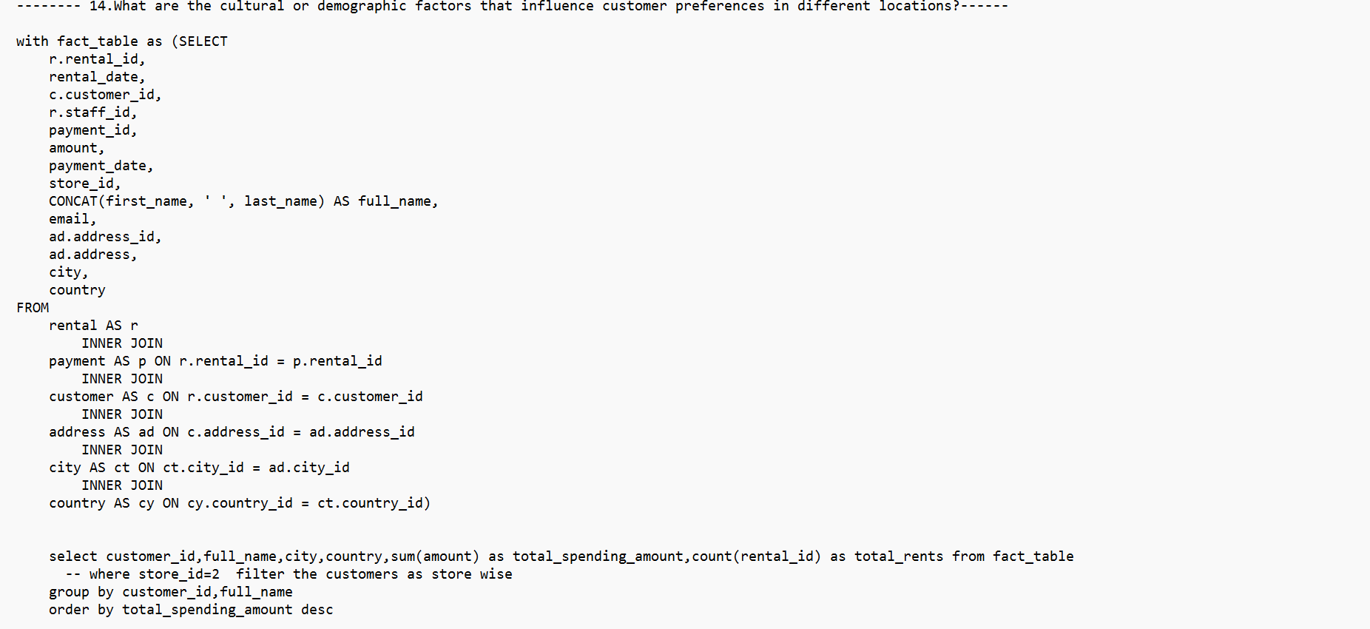
11. What are the demographics and preferences of the highest-spending customers?
Customer_id | Name | City | Country | Total spend amount | Total Rents
526 | KARL SEAL | Cape Coral | United States | 221.55 | 45
148 | ELEANOR HUNT | Saint-Denis | Runion | 216.54 | 46
144 | CLARA SHAW | Molodetno | Belarus | 195.58 | 42
137 | RHONDA KENNEDY | Apeldoorn | Netherlands | 194.61 | 39
178 | MARION SNYDER | Santa Brbara dOeste | Brazil | 194.61 | 39
* The demographics and preferences of the highest-spending customers can vary depending on the Location and the movies. However, there are some general trends that are often observed:
1.Top 2 spending customers are from united states and runion
2.Karl Seal are taking rents from store 2 which is located in Australia
3.Eleanor Hunt are taking rents from store 1 which is located in Canada
4.Both customers spending more than 200 dollars
Movie Rental analysis

Slide 15
12.How does the availability of inventory impact customer satisfaction and repeat business?
* The availability of inventory plays a crucial role in customer satisfaction and repeat business. Here's how:
1.Immediate Gratification
2.Trust and Reliability:
Consistently having inventory in stock builds trust and reliability with customers, which enhances their overall satisfaction.
3.Positive Impression
4.Repeat Customer:
5.Overall, the availability and knowledge of staff play a crucial role in shaping the customer experience and influencing ratings and reviews
Suggestions
1.Implement robust inventory management systems to track film stock levels accurately and forecast demand.
2.Monitor customer demand and trends to anticipate which films will be in high demand.
Movie Rental analysis

Slide 16
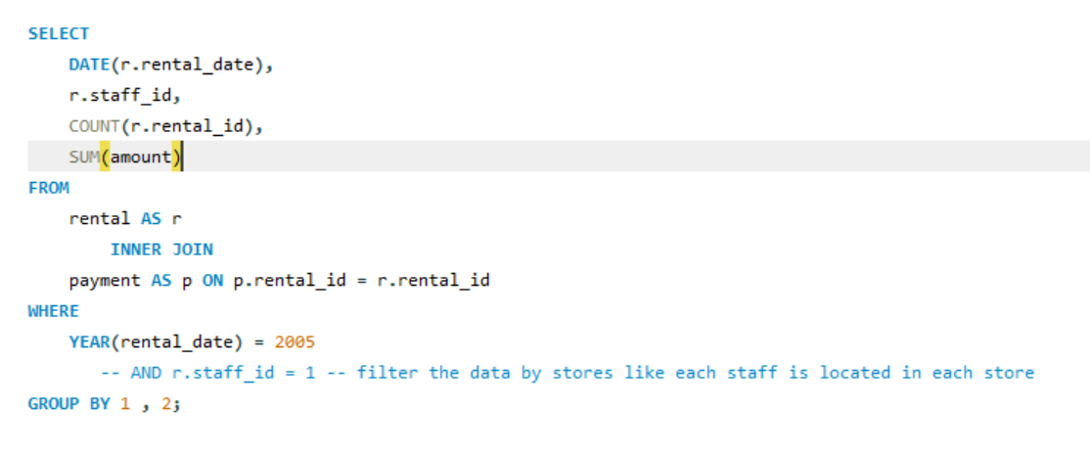
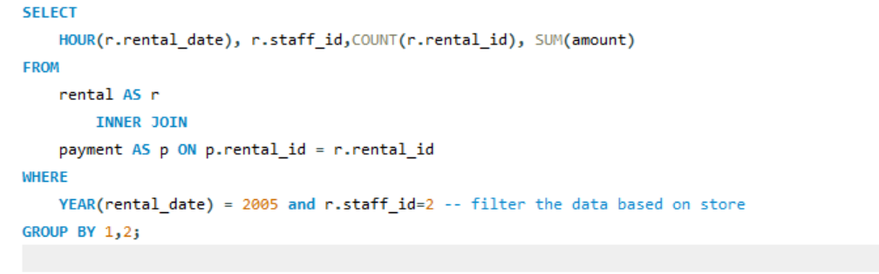
13.What are the busiest hours or days for each store location, and how does it impact staffing requirements?
* Store 1: Canada
The busiest days for Store 1 in terms of total rentals and revenue appear to be around mid-June to late August.
* Busiest Hours in store 1 in terms of rentals has 10,21,18 but every hour cross 300 rentals in store
* Store 2: Australia
The busiest days for Store 2 in terms of total rentals and revenue appear to be around mid-June to late August.
* Busiest Hours in store 2 in terms of rentals has 15,08,0 but every hour cross 300 rentals in store
Suggestions
1.During these busiest days, it's essential to have sufficient staff members available to handle the increased customer demand.
2.Store managers can schedule more staff for those days to ensure that customers receive prompt assistance, shorter wait times, and overall better service.
3. Additionally, additional staff can help with tasks such as restocking inventory, maintaining cleanliness, thereby optimizing operations during peak periods.
Movie Rental analysis

Slide 17
14.What are the cultural or demographic factors that influence customer preferences in different locations?
Customer preferences in different locations are influenced by a variety of cultural, demographic, and socioeconomic factors. Here are some key factors that can shape preference:
1.Language
2.Customer Country
3.Age
4.Gender
5.Economic Factors
Movie Rental analysis

Slide 18
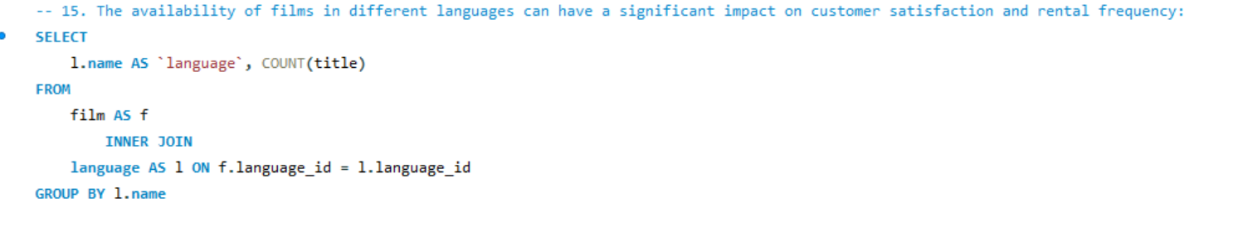
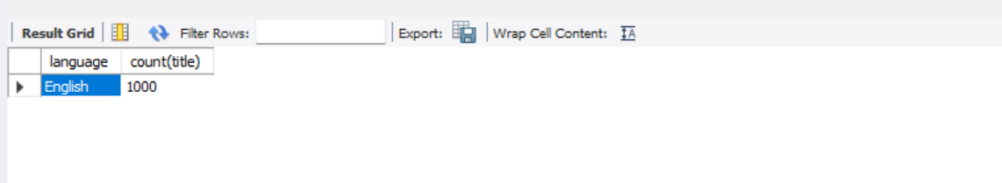
15. How does the availability of films in different languages impact customer satisfaction and rental frequency?
* The availability of films in different languages can have a significant impact on customer satisfaction and rental frequency, But we have only one language English because Canada and Australia has English native language:
1. Customer Satisfaction: Offering films in multiple languages caters to a diverse customer base, enhancing overall satisfaction. This inclusivity contributes to positive Impression and loyalty to the service.
2. Rental Frequency : The availability of films in various languages can increase rental frequency by appealing to a broader audience
3. Word of mouth referrals : Satisfied customers who find films in their preferred language are more likely to recommend the platform to friends and family
Movie Rental analysis

Slide 19
Power Bi

Slide 20
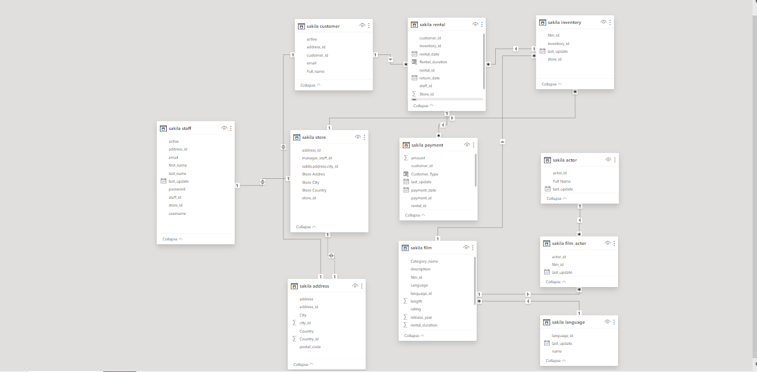
Data Modelling

Slide 21
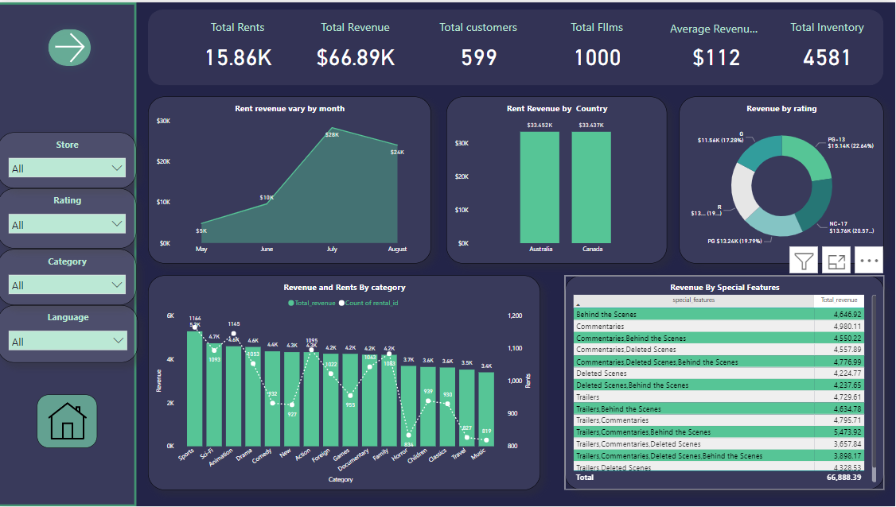
Revenue Analysis

Slide 22
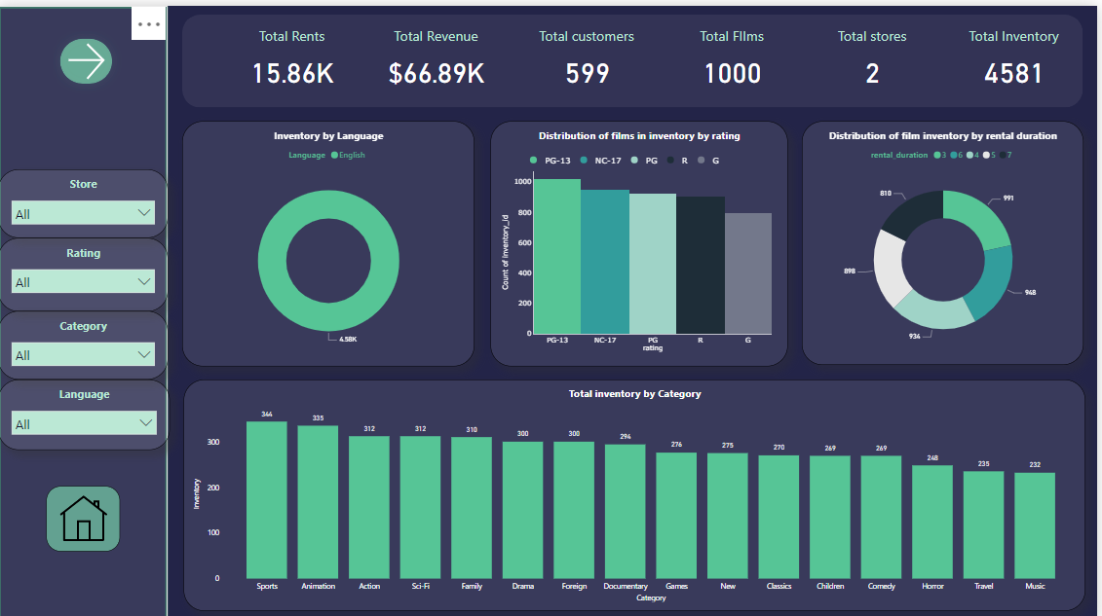
Inventory Analysis

Slide 23
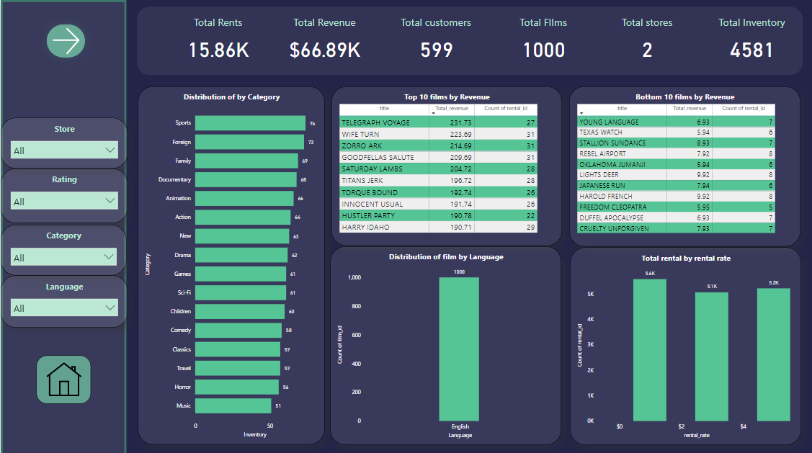
Film Analysis

Slide 24
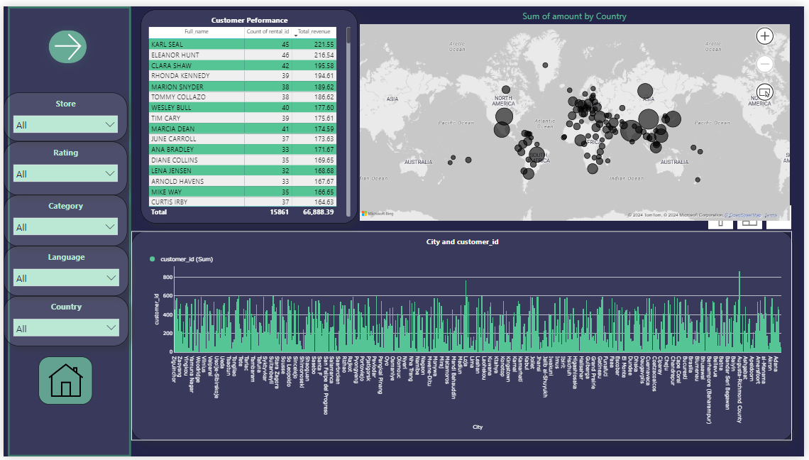
Customer Analysis

Slide 25
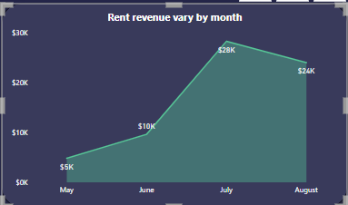
1. How does the sales revenue vary by month?
Summer break in Canada typically lasts from late June to early September, and is usually 8–10 weeks long. So July and August has more rents
Australia's seasons are at opposite to Canada means June to August is winter is Australia. during colder months, customers might prefer staying indoors and renting movies, leading to higher demand.
Based on these seasons we got more revenue and rents in July and august

Slide 26
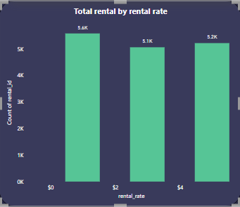
2.What is the distribution of sales by payment method
*In data we have only rental rates for each film ,we don’t have particular payment methods
* in data we have only 0.99,2.99,4.99 dollar rates
* as per the rentals rates 0.99 - 341
2.99 - 336
4.99 - 323 (no of movies )

Slide 27
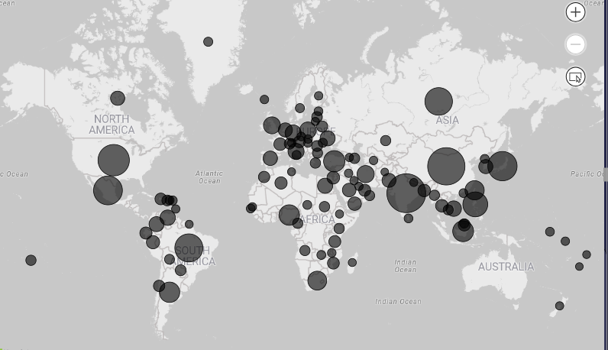
3. Which customer segments generate the highest sales?
* Repeat Customers make more sales as compared to the New customers
*India and China generates highest rents and highest revenue customers

Slide 28
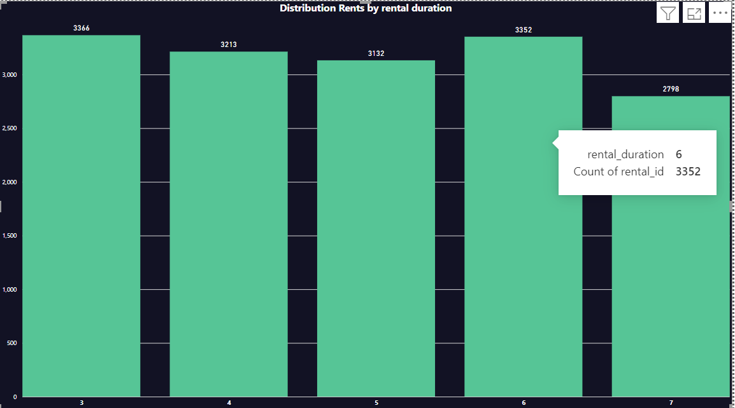
4.What is the distribution of films by rental duration?
* Most of the customers choose all rental durations and but 4 days rental duration have most rents

Slide 29
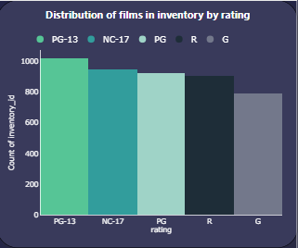
5. How does the inventory vary by film rating?
* Blockbuster Films (PG-13, PG):
These films typically attract a broad audience, including families and young adults. Therefore, Stores may allocate a significant portion of their inventory to blockbuster films to cater to the widest possible customers and maximize rents.
*The inventory for R-rated films may be adjusted based on customers demand and the stores target demographic.
*Art House or Independent Films (Unrated, NC-17):
Art house or independent films often cater to niche audiences interested in unique storytelling, artistic expression, or unconventional themes.
*G-rated films are suitable for general audiences, particularly families with young children.

Slide 30
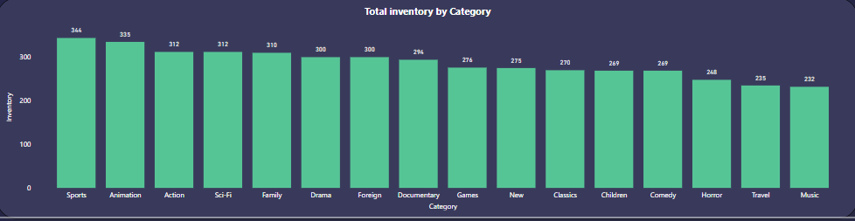
6. What is the breakdown of film categories in the inventory?
The breakdown of film categories in a theater's inventory can vary depending on factors such as audience preferences, market trends, and the theater's strategic objectives. However, here is a general breakdown of common film categories that theaters may include in their inventory
Top Categories
Sports
Animation
Action
Sci-fi
Family

Slide 31
7.What is the distribution of staff by employment duration?
The distribution of staff by employment duration can vary widely depending on factors such as industry, company size, turnover rates, and employee retention strategies. However, here's a general overview of Data we have only 2 staff members and just 4 months of data ,the employment duration not mention in data

Slide 32
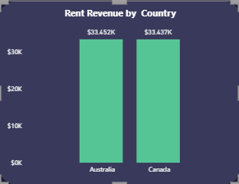
8.How does the store performance vary by location?
Boths Stores performs well in both locations ,store 1 is located in Canada and sore 2 is located in Australia , Both Stores have share of revenue 50 % and 50% in total revenue

Slide 33
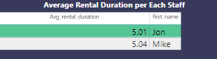
9. What is the average rental duration by staff member?
In DVD store Staff 1 ‘jon’ have 5 days average and Staff 2 ‘mike ‘ have also 5 days average rental duration

Slide 34
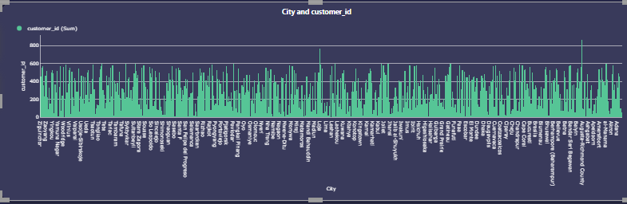
10. What is the distribution of customers across different cities?

Slide 35
11. How does the rental revenue vary by country?
Rental revenue can vary significantly by country due to various factors such as the cost of living, demand for rental properties, property market conditions, government regulations, and cultural preferences.
Both Countries vary rental revenue 50-50%

Slide 36
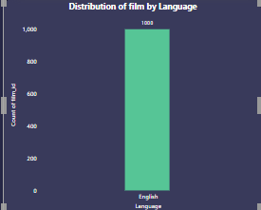
13. What is the distribution of films by language?
DVD Rental Have only one language films because Canada and Australia has native language English

Slide 37
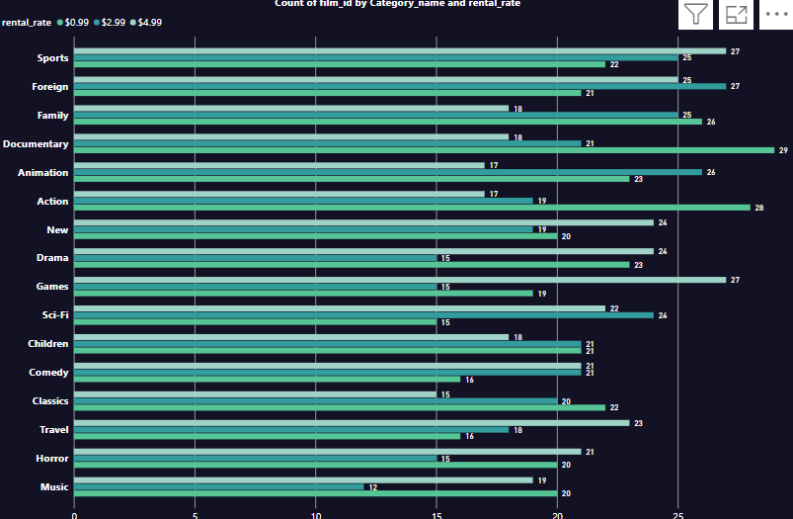
14. Which film categories have the highest rental rates?
Sports, games Highest rental rate films and games
Documentary have low cost movies in count of films as compared to sports

Slide 38
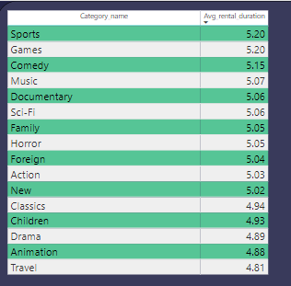
15.How does the average rental duration vary by film category?
* The average rental duration can vary significantly depending on the film category and audience preferences.
Rental durations for these films might be longer as they rely more on word-of-mouth promotion and may take longer to reach a broader audience.
Sports and Games have 5.20 top average rental rate

Slide 39
All Insights
* DVD Rental Store was performed in month of July and august Because of seasonal Tends ,
Canada have Summer break lasts from late June to early September, and is usually 8–10 weeks long.
Holiday periods often see an increase in movie rentals as people have more leisure time and may gather with friends and family.
* Australia's seasons are at opposite to Canada means June to August is winter is Australia. during colder months, customers might prefer staying indoors and renting movies, leading to higher demand.
Suggestions
Sakila DVD Rental Store promoting their business to acquire new customers as compared to repeat customers ,because repat customers rents more than new customers.
Provide some offers in the month of June and July and august for increase in the revenue.
Increase inventory to maintain proper stock of DVDs for customer satisfaction
Develop The films in different languages to acquire the different country customers because everyone wants to prefer native language
Staff also increase to maintain store and customers

Slide 40
APPENDIX
Project on GitHub:
https://github.com/Naveenkumar9959/Movie-Rental-Analysis

